Slide 1
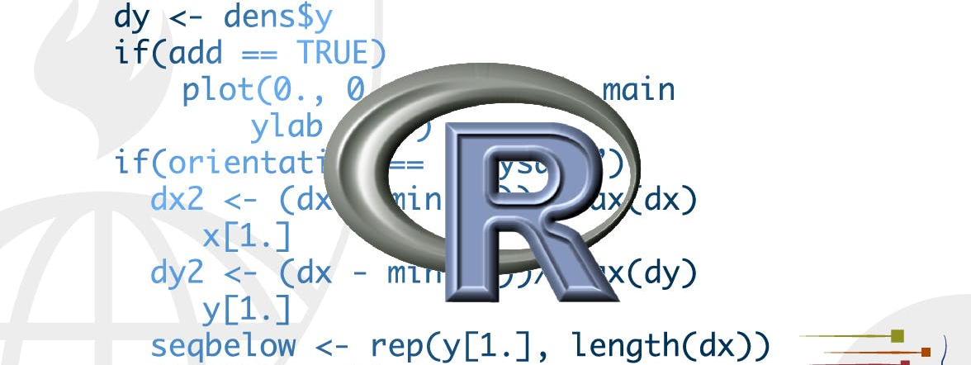
Graphics for communication
STA 4233 Introduction to Programming and Data Management in R
Notes:
In exploratory data analysis, you learned how to use plots as tools for exploration. When you make exploratory plots, you know—even before looking—which variables the plot will display. You made each plot for a purpose, could quickly look at it, and then move on to the next plot. In the course of most analyses, you’ll produce tens or hundreds of plots, most of which are immediately thrown away.
Now that you understand your data, you need to communicate your understanding to others. Your audience will likely not share your background knowledge and will not be deeply invested in the data. To help others quickly build up a good mental model of the data, you will need to invest considerable effort in making your plots as self-explanatory as possible. In this chapter, you’ll learn some of the tools that ggplot2 provides to do so.

Slide 2
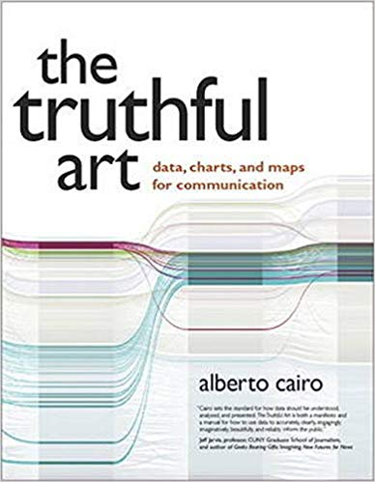
A useful book
The Truthful Art, by Albert Cairo
Notes:
This chapter focuses on the tools you need to create good graphics. I assume that you know what you want, and just need to know how to do it. For that reason, I highly recommend pairing this chapter with a good general visualisation book. I particularly like The Truthful Art, by Albert Cairo. It doesn’t teach the mechanics of creating visualizations, but instead focuses on what you need to think about in order to create effective graphics.
In this chapter, we’ll focus once again on ggplot2. We’ll also use a little dplyr for data manipulation, and a few ggplot2 extension packages, including ggrepel and viridis. Rather than loading those extensions here, we’ll refer to their functions explicitly, using the :: notation. This will help make it clear which functions are built into ggplot2, and which come from other packages. Don’t forget you’ll need to install those packages with install.packages() if you don’t already have them.

Slide 3
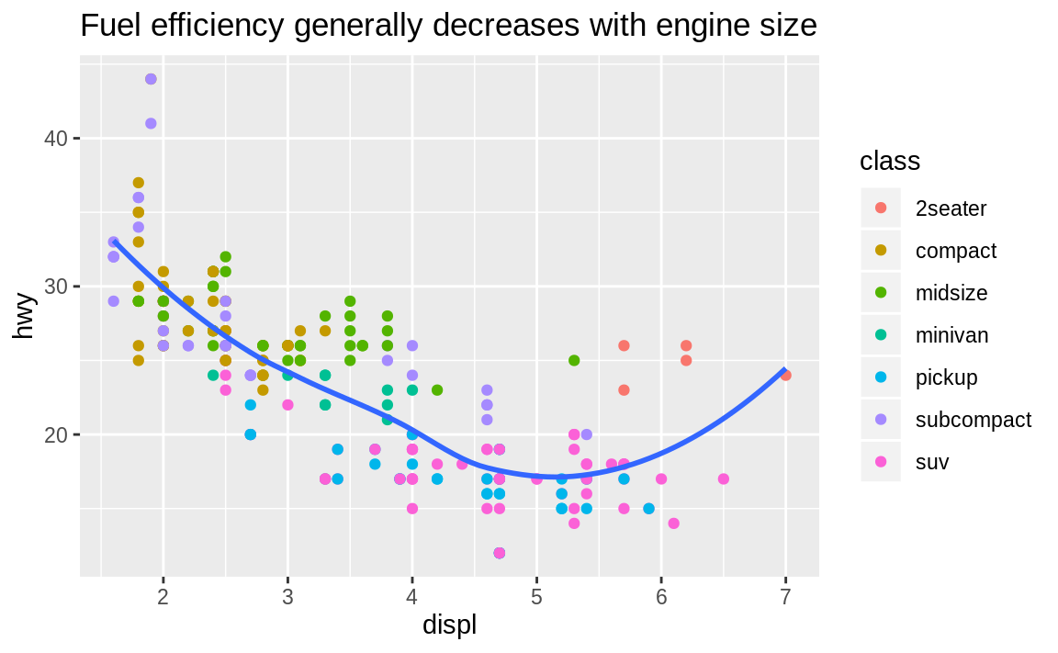
Label
ggplot(mpg, aes(displ, hwy)) +
geom_point(aes(color = class)) +
geom_smooth(se = FALSE) +
labs(title = "Fuel efficiency generally decreases with engine size")
Notes:
The easiest place to start when turning an exploratory graphic into an expository graphic is with good labels. You add labels with the labs() function. This example adds a plot title:
The purpose of a plot title is to summarise the main finding. Avoid titles that just describe what the plot is, e.g. “A scatterplot of engine displacement vs. fuel economy”.

Slide 4
Label
subtitle adds additional detail in a smaller font beneath the title.
caption adds text at the bottom right of the plot, often used to describe the source of the data.
ggplot(mpg, aes(displ, hwy)) +
geom_point(aes(color = class)) +
geom_smooth(se = FALSE) +
labs(
title = "Fuel efficiency generally decreases with engine size",
subtitle = "Two seaters (sports cars) are an exception because of their light weight",
caption = "Data from fueleconomy.gov"
)
Notes:
If you need to add more text, there are two other useful labels that you can use in ggplot2 2.2.0 and above (which should be available by the time you’re reading this book):
subtitle adds additional detail in a smaller font beneath the title.
caption adds text at the bottom right of the plot, often used to describe the source of the data.

Slide 5
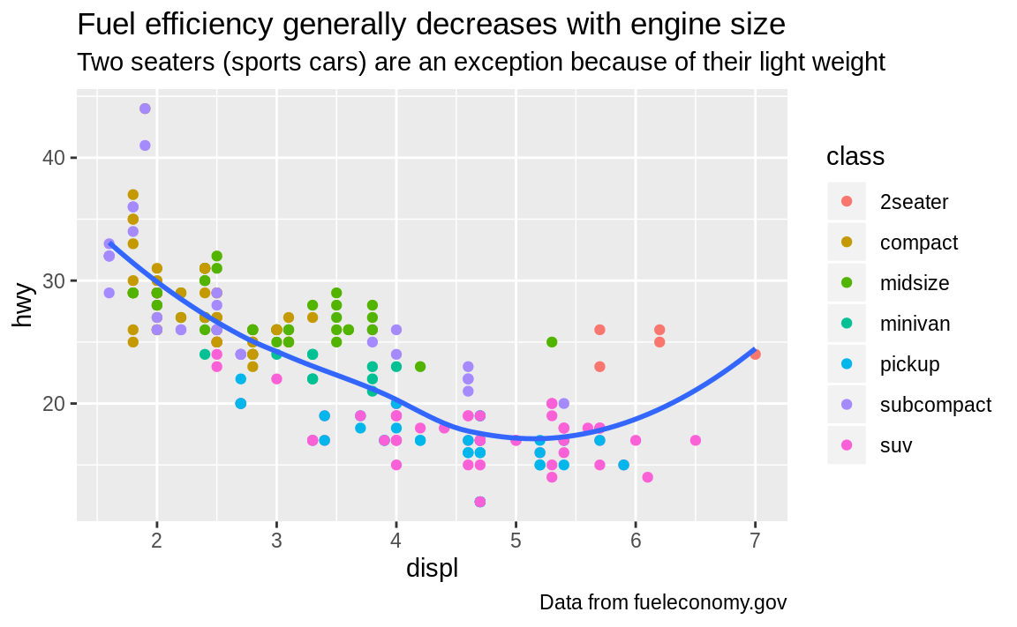

Slide 6
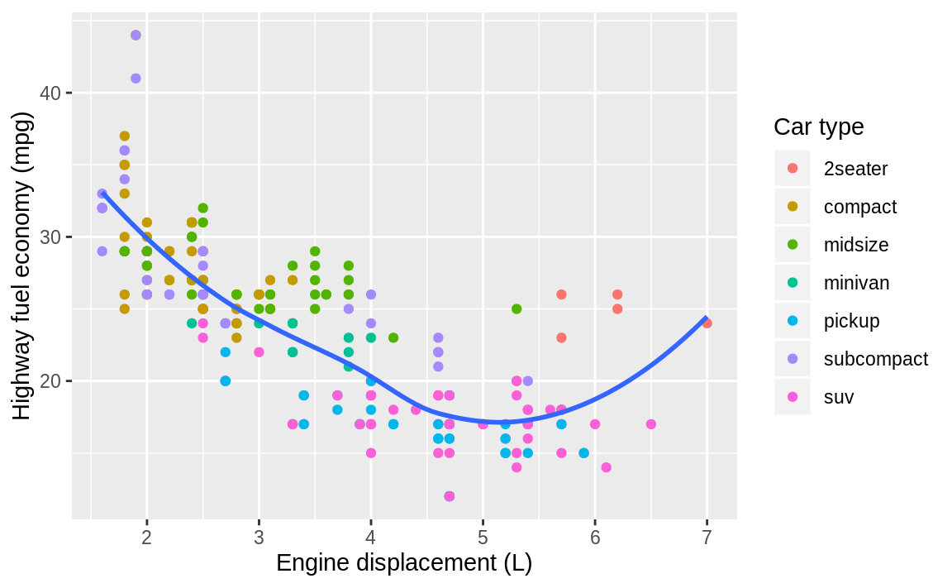
Label
ggplot(mpg, aes(displ, hwy)) +
geom_point(aes(color = class)) +
geom_smooth(se = FALSE) +
labs(
x = "Engine displacement (L)",
y = "Highway fuel economy (mpg)",
color = "Car type"
)
Notes:
You can also use labs() to replace the axis and legend titles. It’s usually a good idea to replace short variable names with more detailed descriptions, and to include the units.

Slide 7
mathematical equations with quote()
df <- tibble(
x = runif(10),
y = runif(10)
)
ggplot(df, aes(x, y)) +
geom_point() +
labs(
x = quote(sum(x[i] ^ 2, i == 1, n)),
y = quote(alpha + beta + frac(delta, theta))
)
Notes:
It’s possible to use mathematical equations instead of text strings. Just switch "" out for quote()

Slide 8
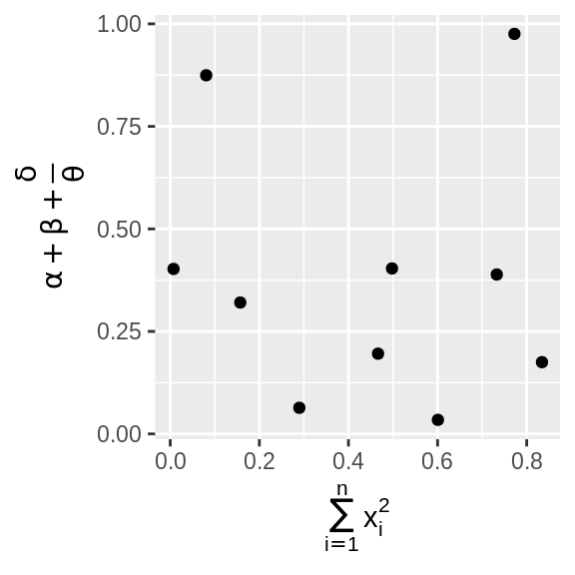
?plotmath
Notes:
and read about the available options in ?plotmath:

Slide 9
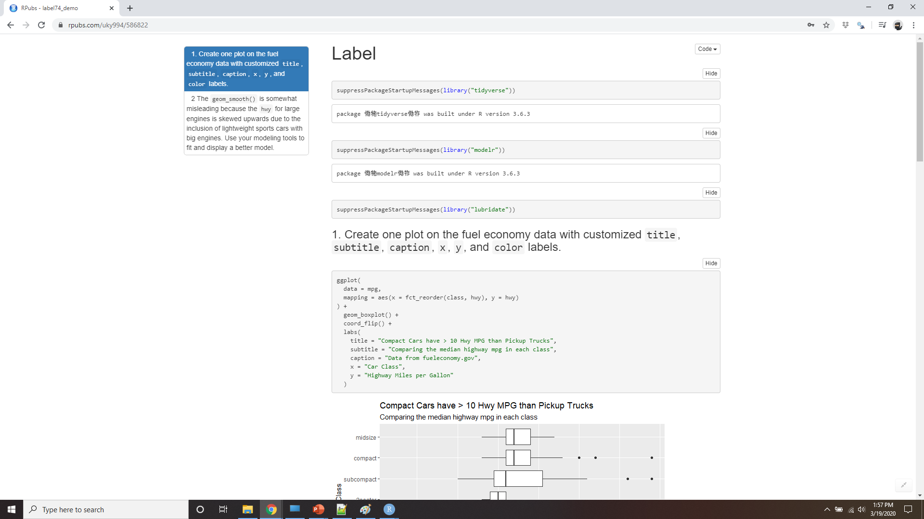
Demo Label
Notes:
https://rpubs.com/uky994/586822
Create one plot on the fuel economy data with customised title, subtitle, caption, x, y, and color labels.
The geom_smooth() is somewhat misleading because the hwy for large engines is skewed upwards due to the inclusion of lightweight sports cars with big engines. Use your modelling tools to fit and display a better model.
Take an exploratory graphic that you’ve created in the last month, and add informative titles to make it easier for others to understand.

Slide 10
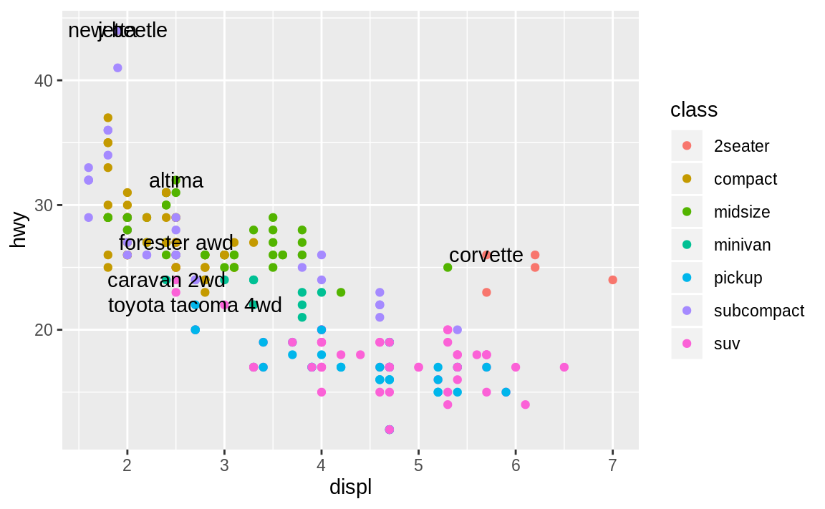
Annotations
best_in_class <- mpg %>%
group_by(class) %>%
filter(row_number(desc(hwy)) == 1)
ggplot(mpg, aes(displ, hwy)) +
geom_point(aes(color = class)) +
geom_text(aes(label = model),
data = best_in_class
)
Notes:
In addition to labelling major components of your plot, it’s often useful to label individual observations or groups of observations. The first tool you have at your disposal is geom_text(). geom_text() is similar to geom_point(), but it has an additional aesthetic: label. This makes it possible to add textual labels to your plots.
There are two possible sources of labels. First, you might have a tibble that provides labels. The plot below isn’t terribly useful, but it illustrates a useful approach: pull out the most efficient car in each class with dplyr, and then label it on the plot:

Slide 11
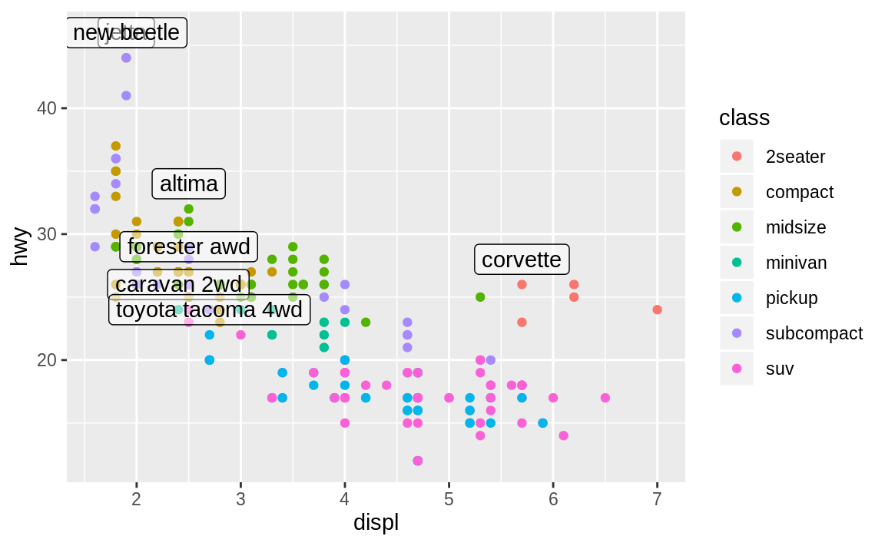
Annotations
ggplot(mpg, aes(displ, hwy)) +
geom_point(aes(color = class)) +
geom_label(aes(label = model), data = best_in_class, nudge_y = 2, alpha = 0.5)
Notes:
This is hard to read because the labels overlap with each other, and with the points. We can make things a little better by switching to geom_label() which draws a rectangle behind the text. We also use the nudge_y parameter to move the labels slightly above the corresponding points:
That helps a bit, but if you look closely in the top-left hand corner, you’ll notice that there are two labels practically on top of each other. This happens because the highway mileage and displacement for the best cars in the compact and subcompact categories are exactly the same. There’s no way that we can fix these by applying the same transformation for every label.

Slide 12
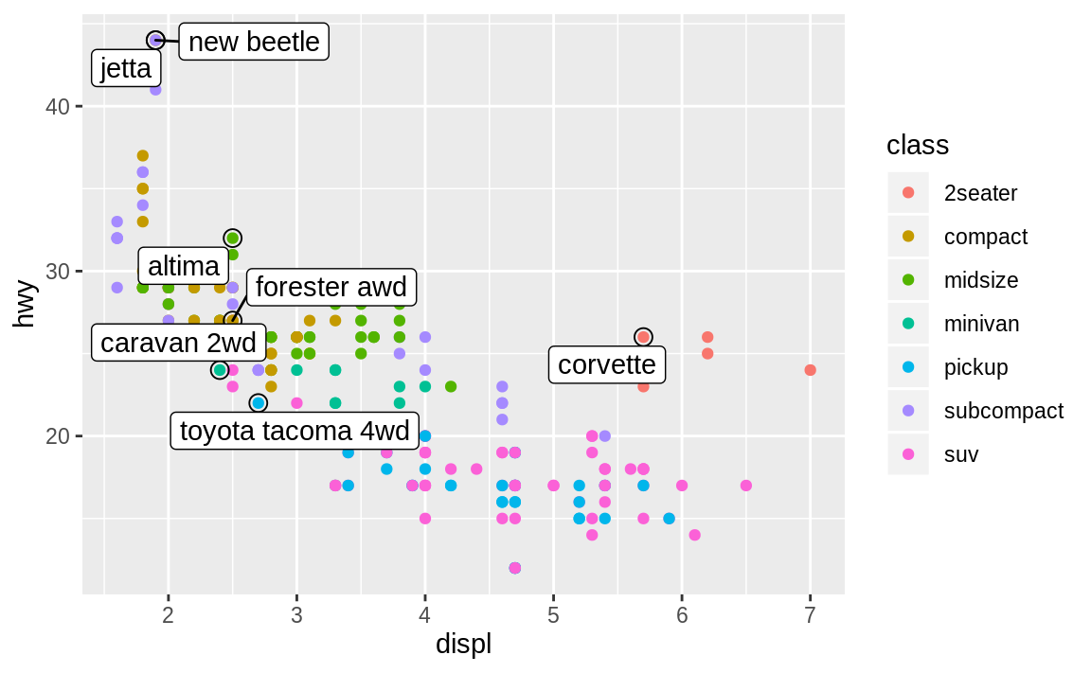
ggrepel
ggplot(mpg, aes(displ, hwy)) +
geom_point(aes(color = class)) +
geom_point(size = 3, shape = 1, data = best_in_class) +
ggrepel::geom_label_repel(aes(label = model), data = best_in_class)
Notes:
Instead, we can use the ggrepel package by Kamil Slowikowski. This useful package will automatically adjust labels so that they don’t overlap:
Note another handy technique used here: I added a second layer of large, hollow points to highlight the points that I’ve labelled.

Slide 13
ggrepel
class_avg <- mpg %>%
group_by(class) %>%
summarize(
displ = median(displ),
hwy = median(hwy)
)
ggplot(mpg, aes(displ, hwy, color = class)) +
ggrepel::geom_label_repel(aes(label = class),
data = class_avg,
size = 6,
label.size = 0,
segment.color = NA
) +
geom_point() +
theme(legend.position = "none")
Notes:
You can sometimes use the same idea to replace the legend with labels placed directly on the plot.

Slide 14
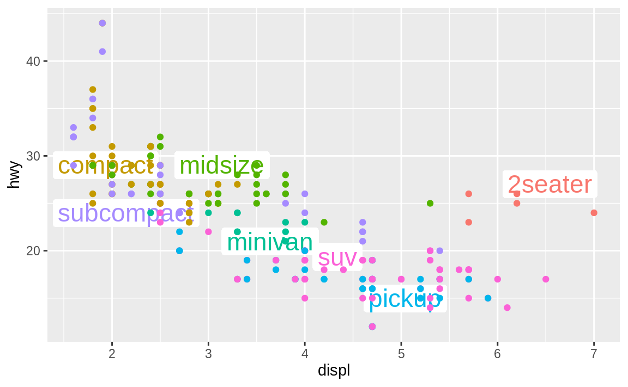
Notes:
It’s not wonderful for this plot, but it isn’t too bad. (theme(legend.position = "none") turns the legend off — we’ll talk about it more shortly.)

Slide 15
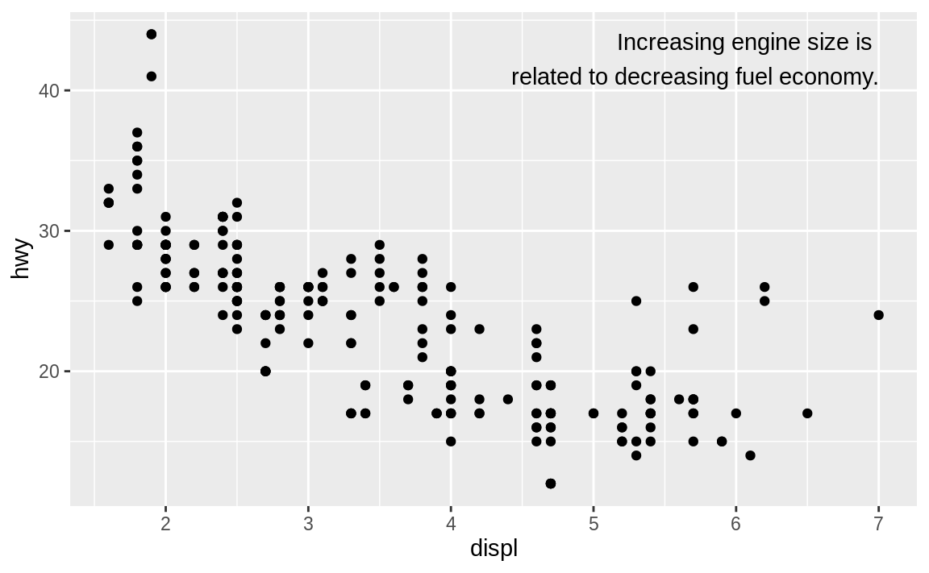
label <- mpg %>%
summarise(
displ = max(displ),
hwy = max(hwy),
label = "Increasing engine size is \nrelated to decreasing fuel economy."
)
ggplot(mpg, aes(displ, hwy)) +
geom_point() +
geom_text(aes(label = label), data = label, vjust = "top", hjust = "right")
Notes:
Alternatively, you might just want to add a single label to the plot, but you’ll still need to create a data frame. Often, you want the label in the corner of the plot, so it’s convenient to create a new data frame using summarise() to compute the maximum values of x and y.

Slide 16
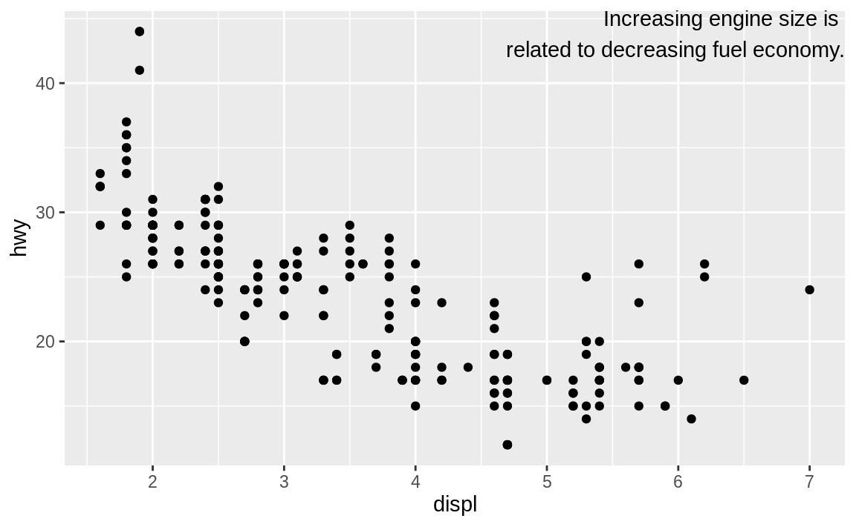
label <- tibble(
displ = Inf,
hwy = Inf,
label = "Increasing engine size is \nrelated to decreasing fuel economy."
)
ggplot(mpg, aes(displ, hwy)) +
geom_point() +
geom_text(aes(label = label), data = label, vjust = "top", hjust = "right")
Notes:
If you want to place the text exactly on the borders of the plot, you can use +Inf and -Inf. Since we’re no longer computing the positions from mpg, we can use tibble() to create the data frame:
In these examples, I manually broke the label up into lines using "\n".

Slide 17
stringr::str_wrap()
"Increasing engine size is related to decreasing fuel economy." %>%
stringr::str_wrap(width = 40) %>%
writeLines()
#> Increasing engine size is related to
#> decreasing fuel economy.
Notes:
Another approach is to use stringr::str_wrap() to automatically add line breaks, given the number of characters you want per line:

Slide 18
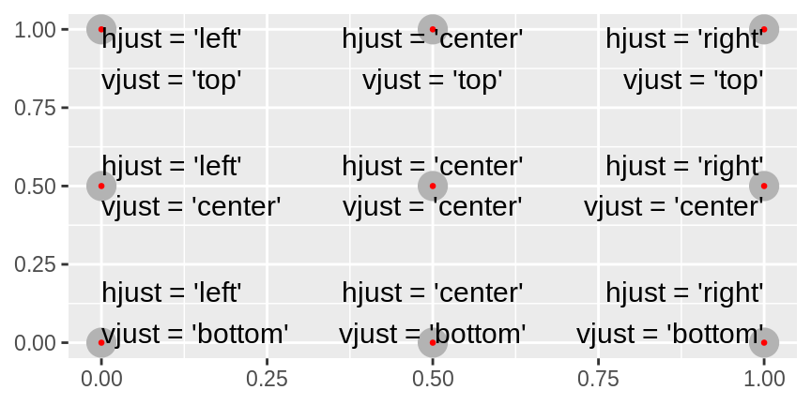
hjust and vjust
Notes:
Note the use of hjust and vjust to control the alignment of the label. Figure shows all nine possible combinations.

Slide 19
other geoms to annotate your plot
Use geom_hline() and geom_vline() to add reference lines.
Use geom_rect() to draw a rectangle around points of interest.
Use geom_segment() with the arrow argument to draw attention to a point with an arrow.
Notes:
Remember, in addition to geom_text(), you have many other geoms in ggplot2 available to help annotate your plot. A few ideas:
Use geom_hline() and geom_vline() to add reference lines. I often make them thick (size = 2) and white (color = white), and draw them underneath the primary data layer. That makes them easy to see, without drawing attention away from the data.
Use geom_rect() to draw a rectangle around points of interest. The boundaries of the rectangle are defined by aesthetics xmin, xmax, ymin, ymax.
Use geom_segment() with the arrow argument to draw attention to a point with an arrow. Use aesthetics x and y to define the starting location, and xend and yend to define the end location.
The only limit is your imagination (and your patience with positioning annotations to be aesthetically pleasing)!

Slide 20
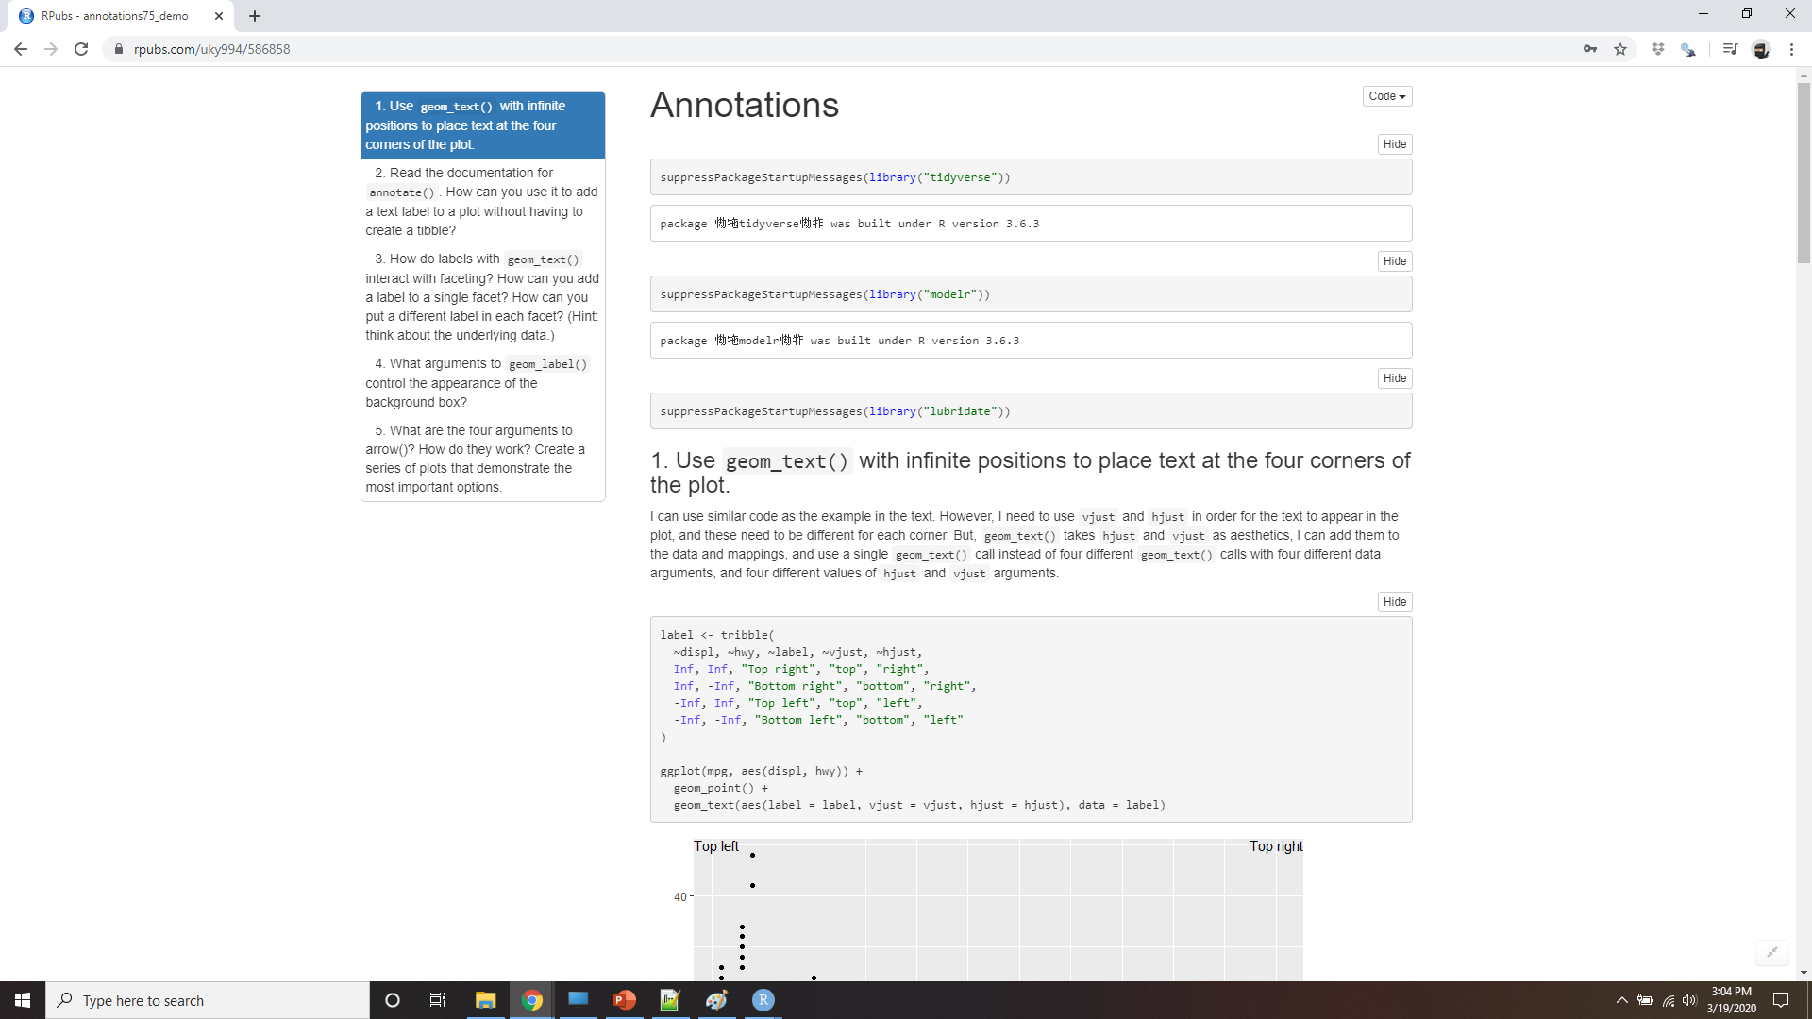
Demo annotations
Notes:
https://rpubs.com/uky994/586858
Use geom_text() with infinite positions to place text at the four corners of the plot.
Read the documentation for annotate(). How can you use it to add a text label to a plot without having to create a tibble?
How do labels with geom_text() interact with faceting? How can you add a label to a single facet? How can you put a different label in each facet? (Hint: think about the underlying data.)
What arguments to geom_label() control the appearance of the background box?
What are the four arguments to arrow()? How do they work? Create a series of plots that demonstrate the most important options.

Slide 21
Scales
ggplot(mpg, aes(displ, hwy)) +
geom_point(aes(color = class))
ggplot(mpg, aes(displ, hwy)) +
geom_point(aes(color = class)) +
scale_x_continuous() +
scale_y_continuous() +
scale_color_discrete()
Notes:
The third way you can make your plot better for communication is to adjust the scales. Scales control the mapping from data values to things that you can perceive. Normally, ggplot2 automatically adds scales for you. For example, when you type:
ggplot2 automatically adds default scales behind the scenes:
Note the naming scheme for scales: scale_ followed by the name of the aesthetic, then _, then the name of the scale. The default scales are named according to the type of variable they align with: continuous, discrete, datetime, or date. There are lots of non-default scales which you’ll learn about next.

Slide 22
scales
You might want to tweak some of the parameters of the default scale.
Change the breaks on the axes
Change the key labels on the legend.
You might want to replace the scale altogether
Notes:
The default scales have been carefully chosen to do a good job for a wide range of inputs. Nevertheless, you might want to override the defaults for two reasons:
You might want to tweak some of the parameters of the default scale. This allows you to do things like change the breaks on the axes, or the key labels on the legend.
You might want to replace the scale altogether, and use a completely different algorithm. Often you can do better than the default because you know more about the data.

Slide 23
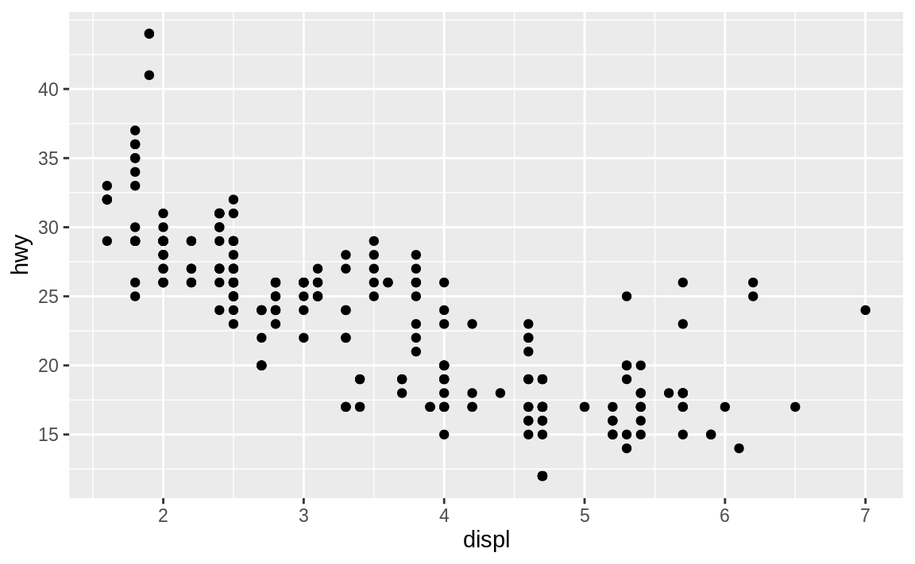
Axis ticks and legend keys
ggplot(mpg, aes(displ, hwy)) +
geom_point() +
scale_y_continuous(breaks = seq(15, 40, by = 5))
Notes:
There are two primary arguments that affect the appearance of the ticks on the axes and the keys on the legend: breaks and labels. Breaks controls the position of the ticks, or the values associated with the keys. Labels controls the text label associated with each tick/key. The most common use of breaks is to override the default choice:

Slide 24
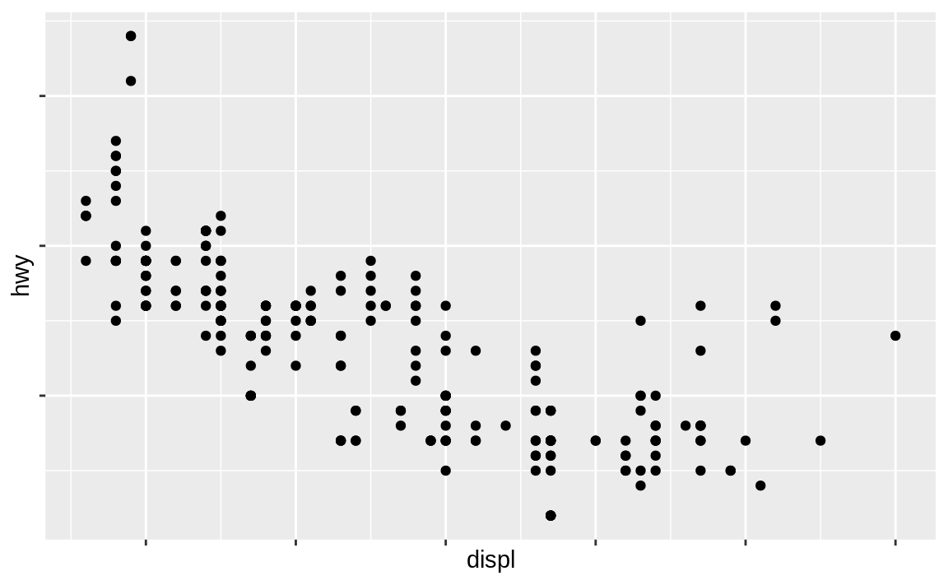
Labels=null
ggplot(mpg, aes(displ, hwy)) +
geom_point() +
scale_x_continuous(labels = NULL) +
scale_y_continuous(labels = NULL)
Notes:
You can use labels in the same way (a character vector the same length as breaks), but you can also set it to NULL to suppress the labels altogether. This is useful for maps, or for publishing plots where you can’t share the absolute numbers.

Slide 25
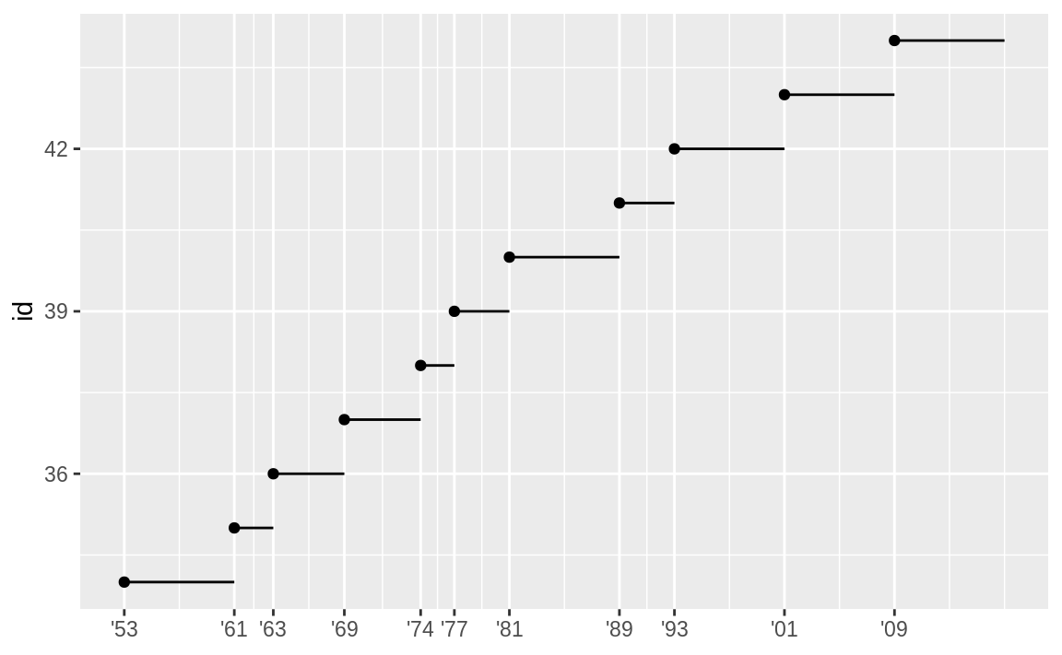
guides
presidential %>% mutate(id = 33 + row_number()) %>%
ggplot(aes(start, id)) +
geom_point() +
geom_segment(aes(xend = end, yend = id)) +
scale_x_date(NULL, breaks = presidential$start, date_labels = "'%y")
Notes:
You can also use breaks and labels to control the appearance of legends. Collectively axes and legends are called guides. Axes are used for x and y aesthetics; legends are used for everything else.
Another use of breaks is when you have relatively few data points and want to highlight exactly where the observations occur. For example, take this plot that shows when each US president started and ended their term.
Note that the specification of breaks and labels for date and datetime scales is a little different:
date_labels takes a format specification, in the same form as parse_datetime().
date_breaks (not shown here), takes a string like “2 days” or “1 month”.

Slide 26
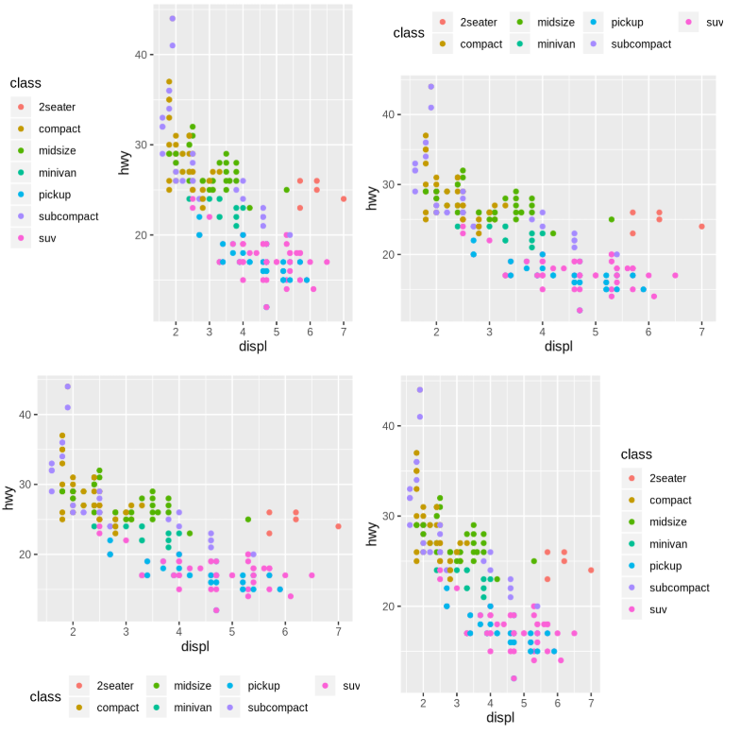
Legend layout
base <- ggplot(mpg, aes(displ, hwy)) +
geom_point(aes(color = class))
base + theme(legend.position = "left")
base + theme(legend.position = "top")
base + theme(legend.position = "bottom")
# the default
base + theme(legend.position = "right")
Notes:
You will most often use breaks and labels to tweak the axes. While they both also work for legends, there are a few other techniques you are more likely to use.
To control the overall position of the legend, you need to use a theme() setting. We’ll come back to themes at the end of the chapter, but in brief, they control the non-data parts of the plot. The theme setting legend.position controls where the legend is drawn:
You can also use legend.position = "none" to suppress the display of the legend altogether.

Slide 27
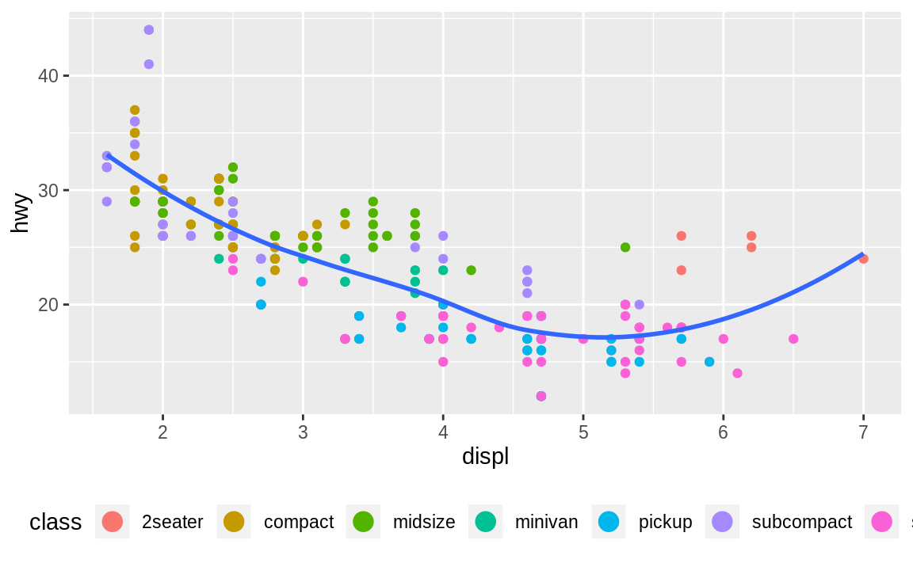
guide_legend() or guide_colorbar()
ggplot(mpg, aes(displ, hwy)) +
geom_point(aes(color = class)) +
geom_smooth(se = FALSE) +
theme(legend.position = "bottom") +
guides(color = guide_legend(nrow = 1, override.aes = list(size = 4)))
#> `geom_smooth()` using method = 'loess' and formula 'y ~ x'
Notes:
To control the display of individual legends, use guides() along with guide_legend() or guide_colorbar(). The following example shows two important settings: controlling the number of rows the legend uses with nrow, and overriding one of the aesthetics to make the points bigger. This is particularly useful if you have used a low alpha to display many points on a plot.

Slide 28
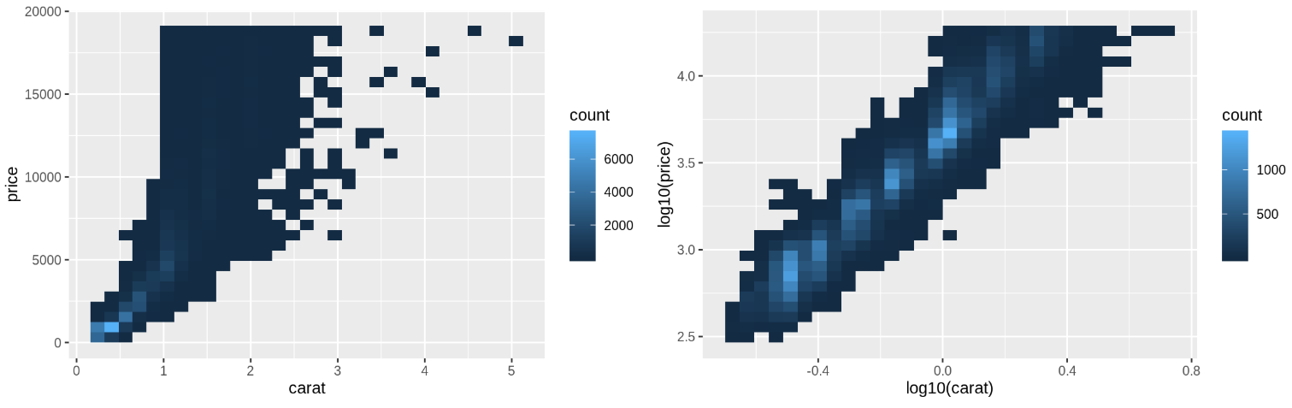
Replacing a scale
ggplot(diamonds, aes(carat, price)) +
geom_bin2d()
ggplot(diamonds, aes(log10(carat), log10(price))) +
geom_bin2d()
Notes:
Instead of just tweaking the details a little, you can instead replace the scale altogether. There are two types of scales you’re mostly likely to want to switch out: continuous position scales and color scales. Fortunately, the same principles apply to all the other aesthetics, so once you’ve mastered position and color, you’ll be able to quickly pick up other scale replacements.
It’s very useful to plot transformations of your variable. For example, as we’ve seen in diamond prices it’s easier to see the precise relationship between carat and price if we log transform them:

Slide 29
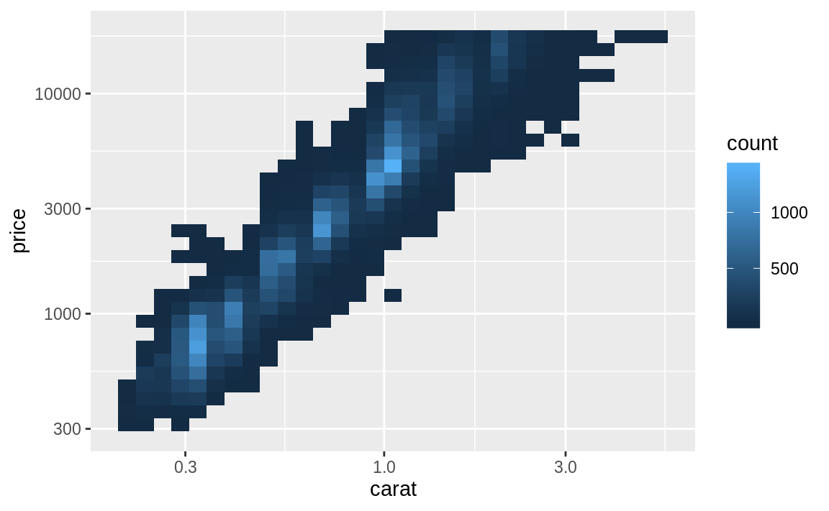
Do it with scale()
ggplot(diamonds, aes(carat, price)) +
geom_bin2d() +
scale_x_log10() +
scale_y_log10()
Notes:
However, the disadvantage of this transformation is that the axes are now labelled with the transformed values, making it hard to interpret the plot. Instead of doing the transformation in the aesthetic mapping, we can instead do it with the scale. This is visually identical, except the axes are labelled on the original data scale.

Slide 30
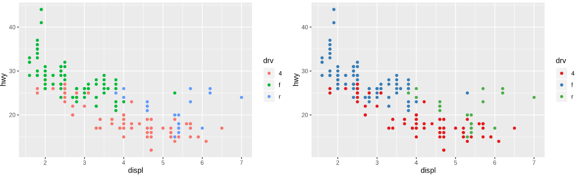
ColorBrewer scales
ggplot(mpg, aes(displ, hwy)) +
geom_point(aes(color = drv))
ggplot(mpg, aes(displ, hwy)) +
geom_point(aes(color = drv)) +
scale_color_brewer(palette = "Set1")
Notes:
Another scale that is frequently customized is color. The default categorical scale picks colors that are evenly spaced around the color wheel. Useful alternatives are the ColorBrewer scales which have been hand tuned to work better for people with common types of color blindness. The two plots below look similar, but there is enough difference in the shades of red and green that the dots on the right can be distinguished even by people with red-green color blindness.

Slide 31
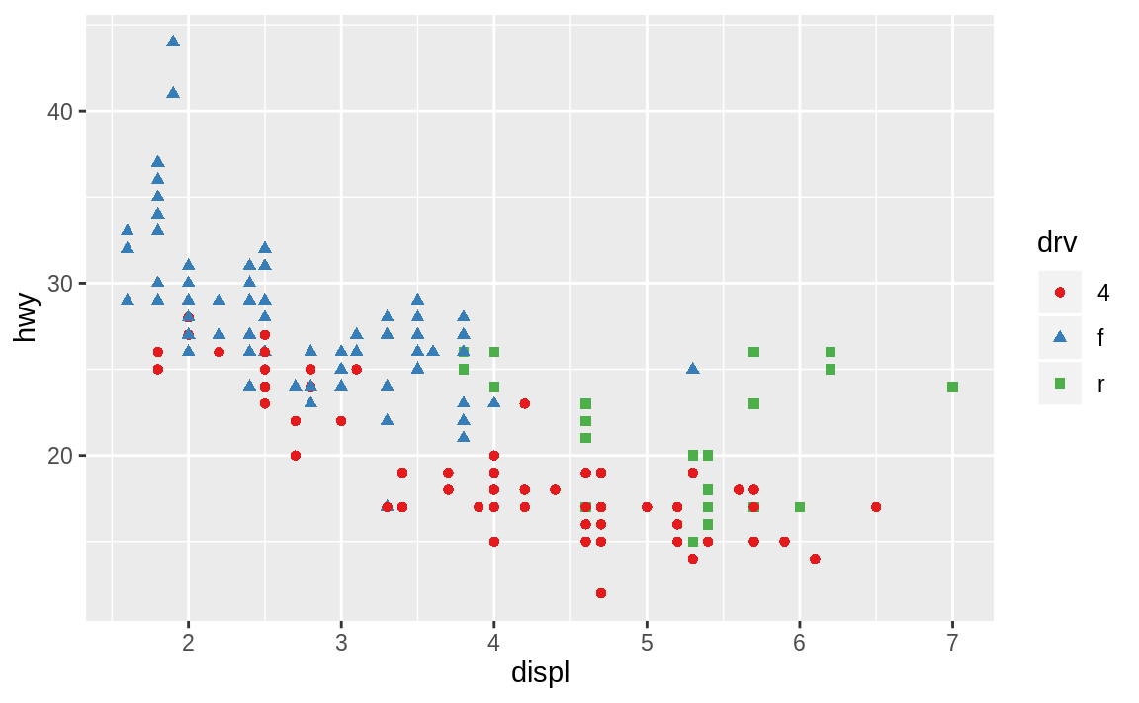
redundant shape mapping
ggplot(mpg, aes(displ, hwy)) +
geom_point(aes(color = drv, shape = drv)) +
scale_color_brewer(palette = "Set1")
Notes:
Don’t forget simpler techniques. If there are just a few colors, you can add a redundant shape mapping. This will also help ensure your plot is interpretable in black and white.

Slide 32
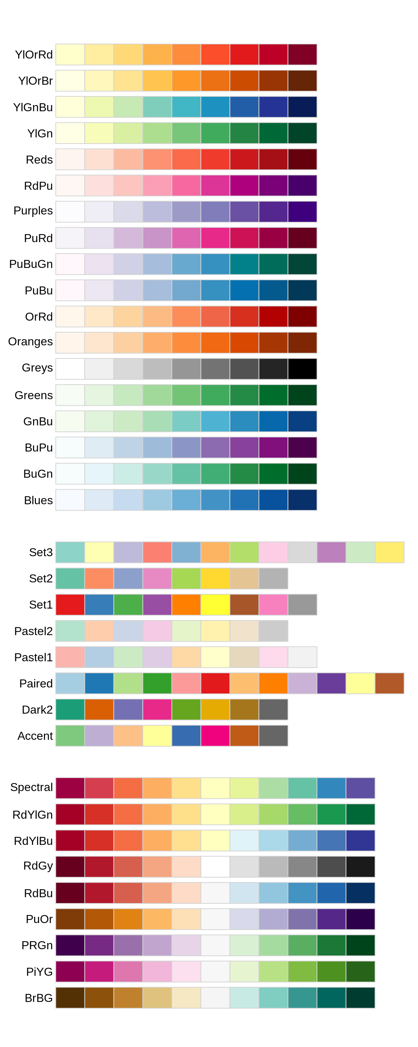
RColorBrewer
http://colorbrewer2.org/
Notes:
The ColorBrewer scales are documented online at http://colorbrewer2.org/ and made available in R via the RColorBrewer package, by Erich Neuwirth. Figure shows the complete list of all palettes. The sequential (top) and diverging (bottom) palettes are particularly useful if your categorical values are ordered, or have a “middle”. This often arises if you’ve used cut() to make a continuous variable into a categorical variable.

Slide 33
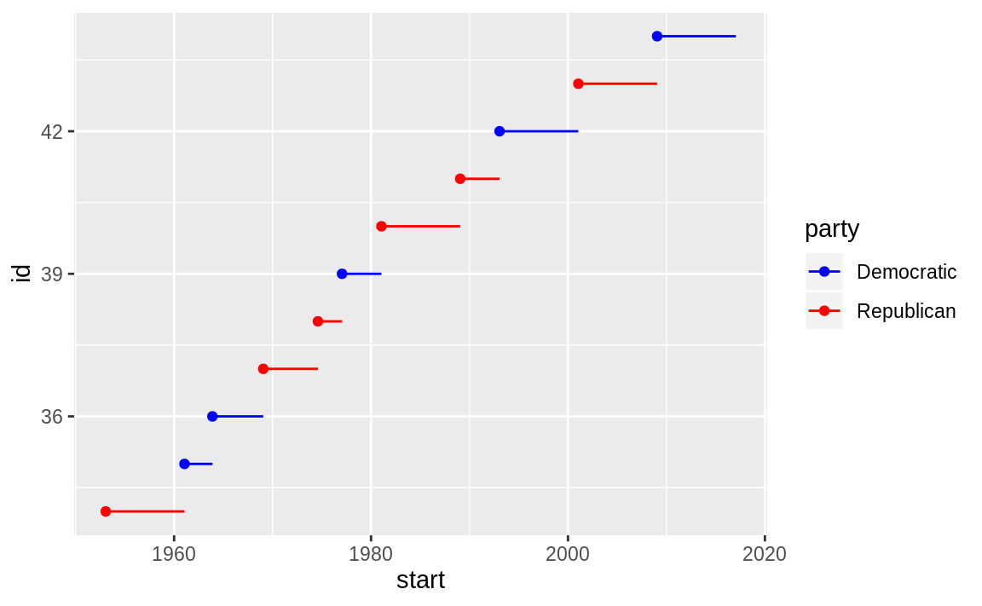
scale_color_manual()
presidential %>%
mutate(id = 33 + row_number()) %>%
ggplot(aes(start, id, color = party)) +
geom_point() +
geom_segment(aes(xend = end, yend = id)) +
scale_color_manual(values = c(Republican = "red", Democratic = "blue"))
Notes:
When you have a predefined mapping between values and colors, use scale_color_manual(). For example, if we map presidential party to color, we want to use the standard mapping of red for Republicans and blue for Democrats:
For continuous color, you can use the built-in scale_color_gradient() or scale_fill_gradient(). If you have a diverging scale, you can use scale_color_gradient2(). That allows you to give, for example, positive and negative values different colors. That’s sometimes also useful if you want to distinguish points above or below the mean.

Slide 34
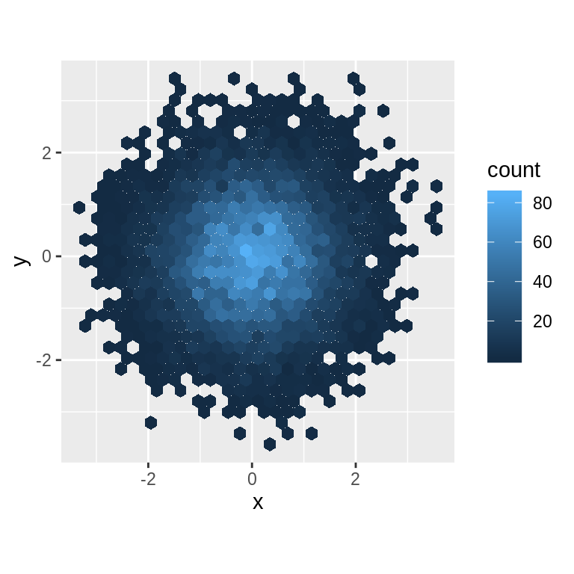
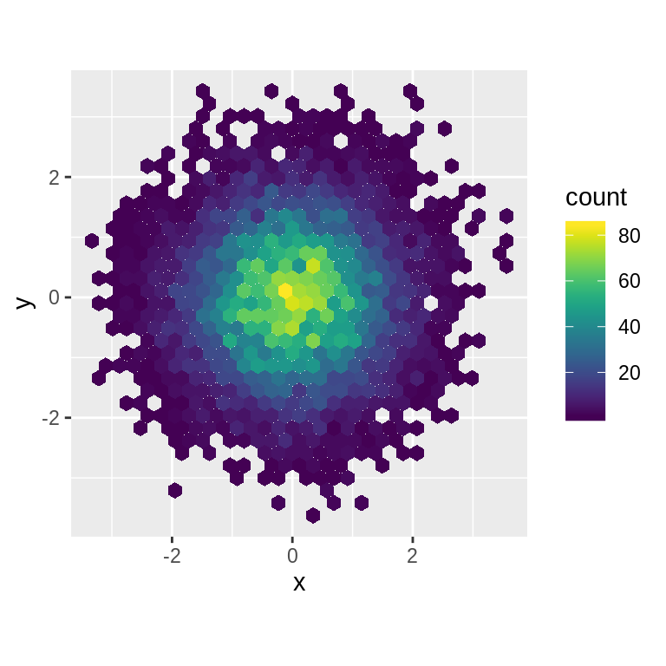
the viridis package
df <- tibble(
x = rnorm(10000),
y = rnorm(10000)
)
ggplot(df, aes(x, y)) +
geom_hex() +
coord_fixed()
ggplot(df, aes(x, y)) +
geom_hex() +
viridis::scale_fill_viridis() +
coord_fixed()
Notes:
Another option is scale_colour_viridis() provided by the viridis package. It’s a continuous analog of the categorical ColorBrewer scales. The designers, Nathaniel Smith and Stéfan van der Walt, carefully tailored a continuous colour scheme that has good perceptual properties. Here’s an example from the viridis vignette.

Slide 35
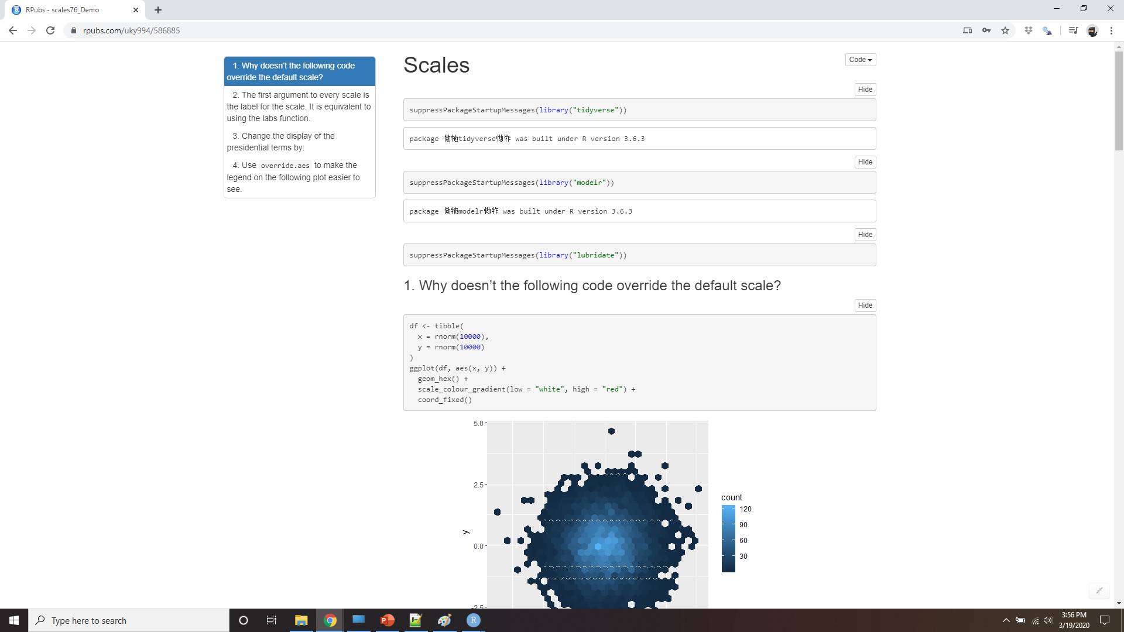
Demo scales
Notes:
https://rpubs.com/uky994/586885
Why doesn’t the following code override the default scale?
ggplot(df, aes(x, y)) + geom_hex() + scale_colour_gradient(low = "white", high = "red") + coord_fixed()
What is the first argument to every scale? How does it compare to labs()?
Change the display of the presidential terms by:
Combining the two variants shown above.
Improving the display of the y axis.
Labelling each term with the name of the president.
Adding informative plot labels.
Placing breaks every 4 years (this is trickier than it seems!).
Use override.aes to make the legend on the following plot easier to see.
ggplot(diamonds, aes(carat, price)) + geom_point(aes(colour = cut), alpha = 1/20)

Slide 36
Zooming
Adjusting what data are plotted
Setting the limits in each scale
Setting xlim and ylim in coord_cartesian()
Notes:
There are three ways to control the plot limits:
Adjusting what data are plotted
Setting the limits in each scale
Setting xlim and ylim in coord_cartesian()

Slide 37
zooming
ggplot(mpg, mapping = aes(displ, hwy)) +
geom_point(aes(color = class)) +
geom_smooth() +
coord_cartesian(xlim = c(5, 7), ylim = c(10, 30))
mpg %>%
filter(displ >= 5, displ <= 7, hwy >= 10, hwy <= 30) %>%
ggplot(aes(displ, hwy)) +
geom_point(aes(color = class)) +
geom_smooth()
Notes:
To zoom in on a region of the plot, it’s generally best to use coord_cartesian(). Compare the following two plots:

Slide 38
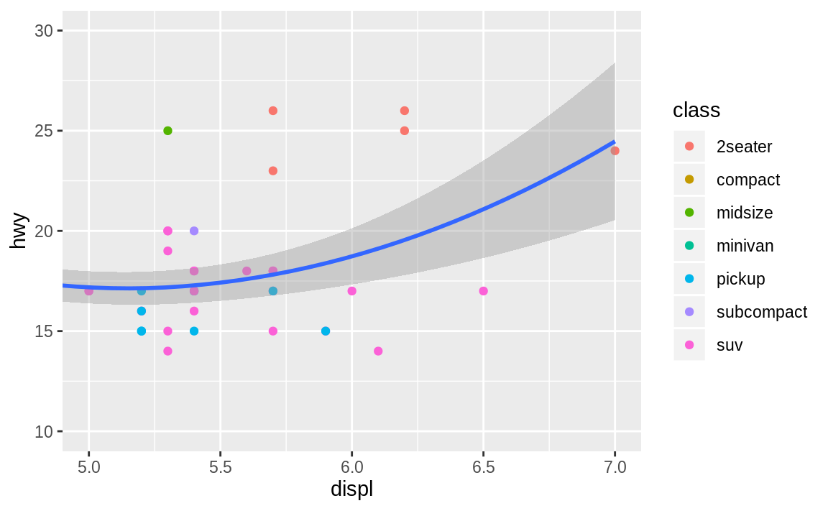
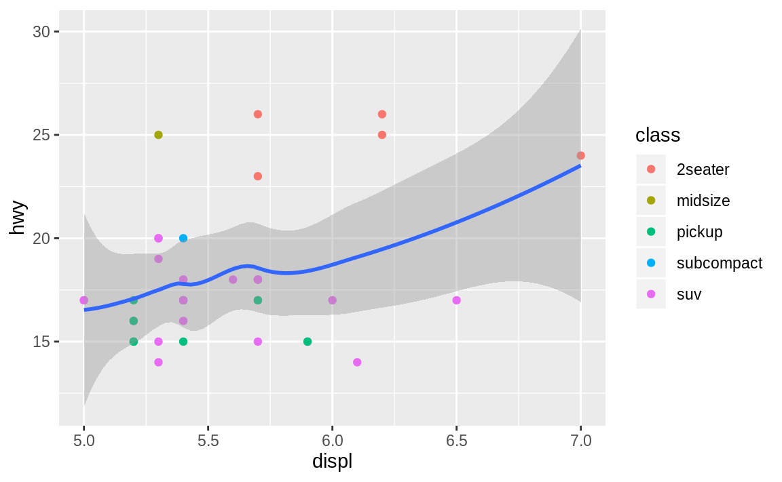
zooming

Slide 39
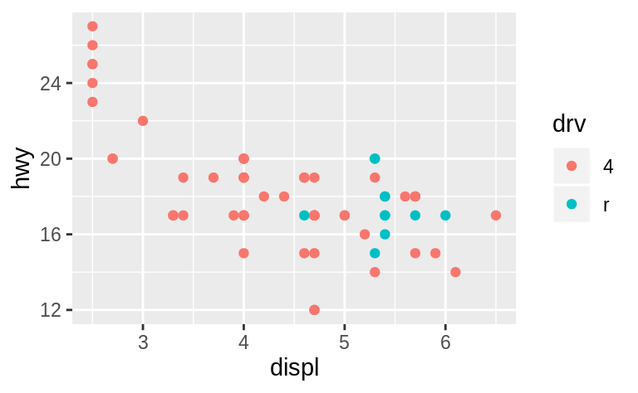
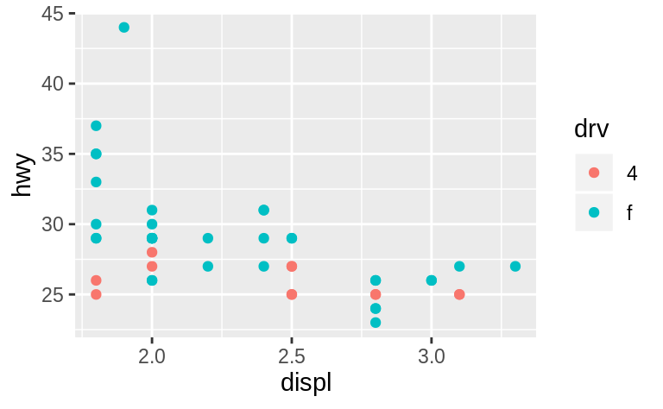
Set limits
suv <- mpg %>% filter(class == "suv")
compact <- mpg %>% filter(class == "compact")
ggplot(suv, aes(displ, hwy, colour = drv)) + geom_point()
ggplot(compact, aes(displ, hwy, colour = drv)) + geom_point()
Notes:
You can also set the limits on individual scales. Reducing the limits is basically equivalent to subsetting the data. It is generally more useful if you want expand the limits, for example, to match scales across different plots. For example, if we extract two classes of cars and plot them separately, it’s difficult to compare the plots because all three scales (the x-axis, the y-axis, and the colour aesthetic) have different ranges.

Slide 40
Share scales
x_scale <- scale_x_continuous(limits = range(mpg$displ))
y_scale <- scale_y_continuous(limits = range(mpg$hwy))
col_scale <- scale_colour_discrete(limits = unique(mpg$drv))
ggplot(suv, aes(displ, hwy, colour = drv)) +
geom_point() + x_scale + y_scale + col_scale
ggplot(compact, aes(displ, hwy, colour = drv)) +
geom_point() + x_scale + y_scale + col_scale
Notes:
One way to overcome this problem is to share scales across multiple plots, training the scales with the limits of the full data.

Slide 41
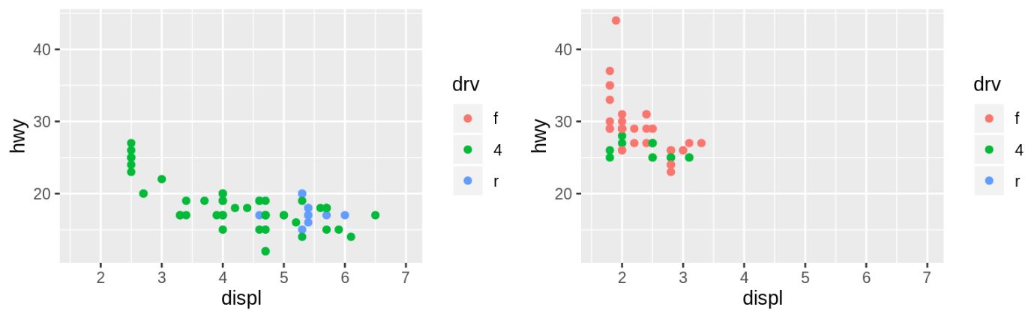
Share scales
Notes:
In this particular case, you could have simply used faceting, but this technique is useful more generally, if for instance, you want spread plots over multiple pages of a report.

Slide 42
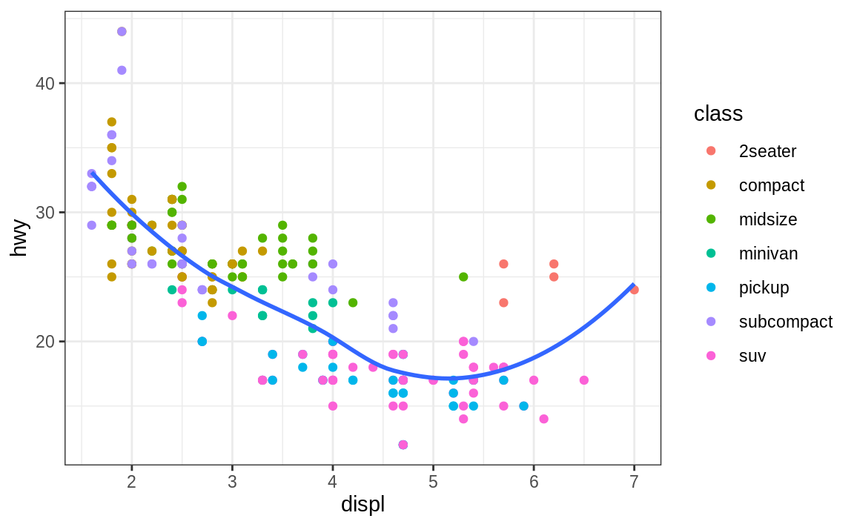
Themes
ggplot(mpg, aes(displ, hwy)) +
geom_point(aes(color = class)) +
geom_smooth(se = FALSE) +
theme_bw()
Notes:
Finally, you can customise the non-data elements of your plot with a theme:

Slide 43
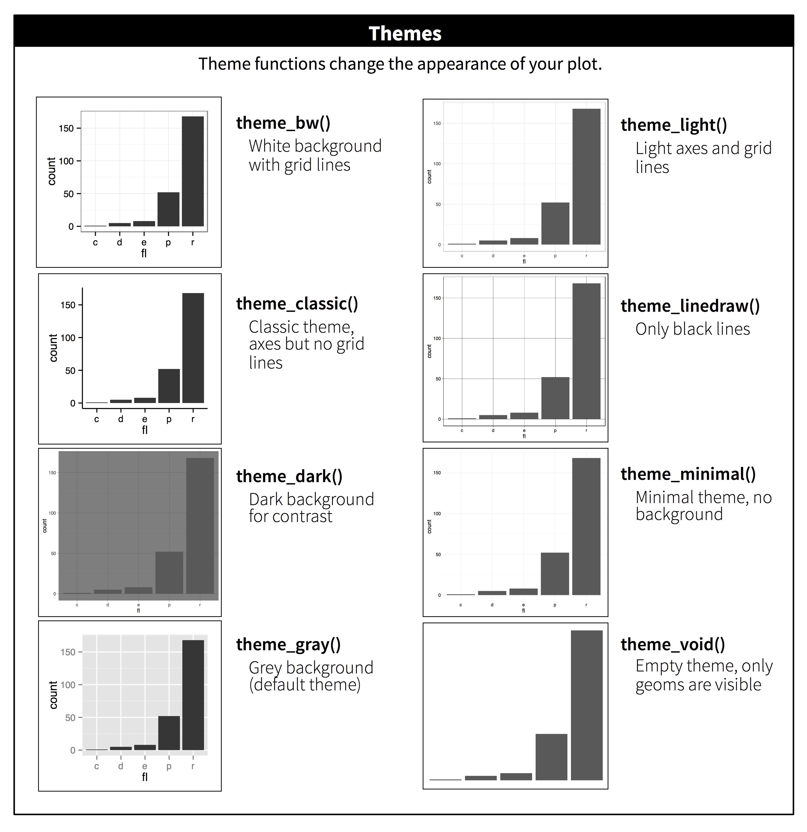
themes
https://github.com/jrnold/ggthemes
Notes:
ggplot2 includes eight themes by default, as shown in Figure 28.3. Many more are included in add-on packages like ggthemes (https://github.com/jrnold/ggthemes), by Jeffrey Arnold.
Many people wonder why the default theme has a grey background. This was a deliberate choice because it puts the data forward while still making the grid lines visible. The white grid lines are visible (which is important because they significantly aid position judgements), but they have little visual impact and we can easily tune them out. The grey background gives the plot a similar typographic colour to the text, ensuring that the graphics fit in with the flow of a document without jumping out with a bright white background. Finally, the grey background creates a continuous field of colour which ensures that the plot is perceived as a single visual entity.
It’s also possible to control individual components of each theme, like the size and colour of the font used for the y axis. Unfortunately, this level of detail is outside the scope of this book, so you’ll need to read the ggplot2 book for the full details. You can also create your own themes, if you are trying to match a particular corporate or journal style.

Slide 44

Saving your plots
ggplot(mpg, aes(displ, hwy)) + geom_point()
ggsave("my-plot.pdf")
#> Saving 6 x 3.7 in image
Notes:
There are two main ways to get your plots out of R and into your final write-up: ggsave() and knitr. ggsave() will save the most recent plot to disk:
f you don’t specify the width and height they will be taken from the dimensions of the current plotting device. For reproducible code, you’ll want to specify them.
Generally, however, I think you should be assembling your final reports using R Markdown, so I want to focus on the important code chunk options that you should know about for graphics. You can learn more about ggsave() in the documentation.

Slide 45
Figure sizing
I find it most aesthetically pleasing for plots to have a consistent width.
set fig.width = 6 (6")
fig.asp = 0.618 (the golden ratio)
I may adjust fig.asp in individual chunks
I control the output size with out.width and set it to a percentage of the line width.
out.width = "70%"
fig.align = "center"
To put multiple plots in a single row
I set the out.width to 50% for two plots, 33% for 3 plots, or 25% to 4 plots
fig.align = "default"
Notes:
The biggest challenge of graphics in R Markdown is getting your figures the right size and shape. There are five main options that control figure sizing: fig.width, fig.height, fig.asp, out.width and out.height. Image sizing is challenging because there are two sizes (the size of the figure created by R and the size at which it is inserted in the output document), and multiple ways of specifying the size (i.e., height, width, and aspect ratio: pick two of three).
I find it most aesthetically pleasing for plots to have a consistent width. To enforce this, I set fig.width = 6 (6") and fig.asp = 0.618 (the golden ratio) in the defaults. Then in individual chunks, I only adjust fig.asp.
I control the output size with out.width and set it to a percentage of the line width. I default to out.width = "70%" and fig.align = "center". That give plots room to breathe, without taking up too much space.
To put multiple plots in a single row I set the out.width to 50% for two plots, 33% for 3 plots, or 25% to 4 plots, and set fig.align = "default". Depending on what I’m trying to illustrate ( e.g. show data or show plot variations), I’ll also tweak fig.width, as discussed below.

